Slide 1
Canal & River Trust waterways and land ownership in LCR

Slide 2
The Ribbon
Allows you to import a video or an Excel chart into a placeholder *
Allows you to insert a new slide from the library
Changes the colour of selected objects or text
Removes or adds the logo on the slide
Recalls the presentation details so they can be edited
Creates a new
Trust presentation
Formats text to the correct styles
Allows you to insert an image into a placeholder or to add a background image to an title or end slide
Removes or adds the underline under the slide title on a slide
Displays the version number of the template
* Use the standard Insert > Chart option to create new charts in PowerPoint, or use the Trust PowerPoint Templates > Chart from Excel option to insert existing charts from Excel. This automatically formats the chart colours. See User Guide for how to do this.

Slide 3
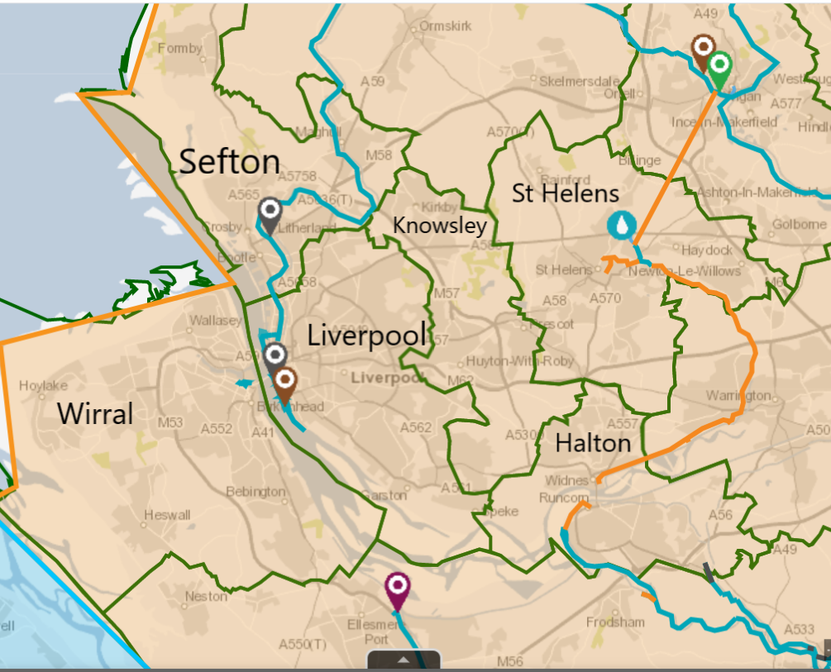
Wider Liverpool City Region
District | Waterway
Liverpool | Liverpool South Docks Riverside Walkway Leeds & Liverpool Canal
Sefton | Leeds & Liverpool Canal
St Helens | St Helens/Sankey Canal Carr Mill Dam
Halton | Weaver Navigation
Wirral | Morpeth Dock Egerton Dock

Slide 4
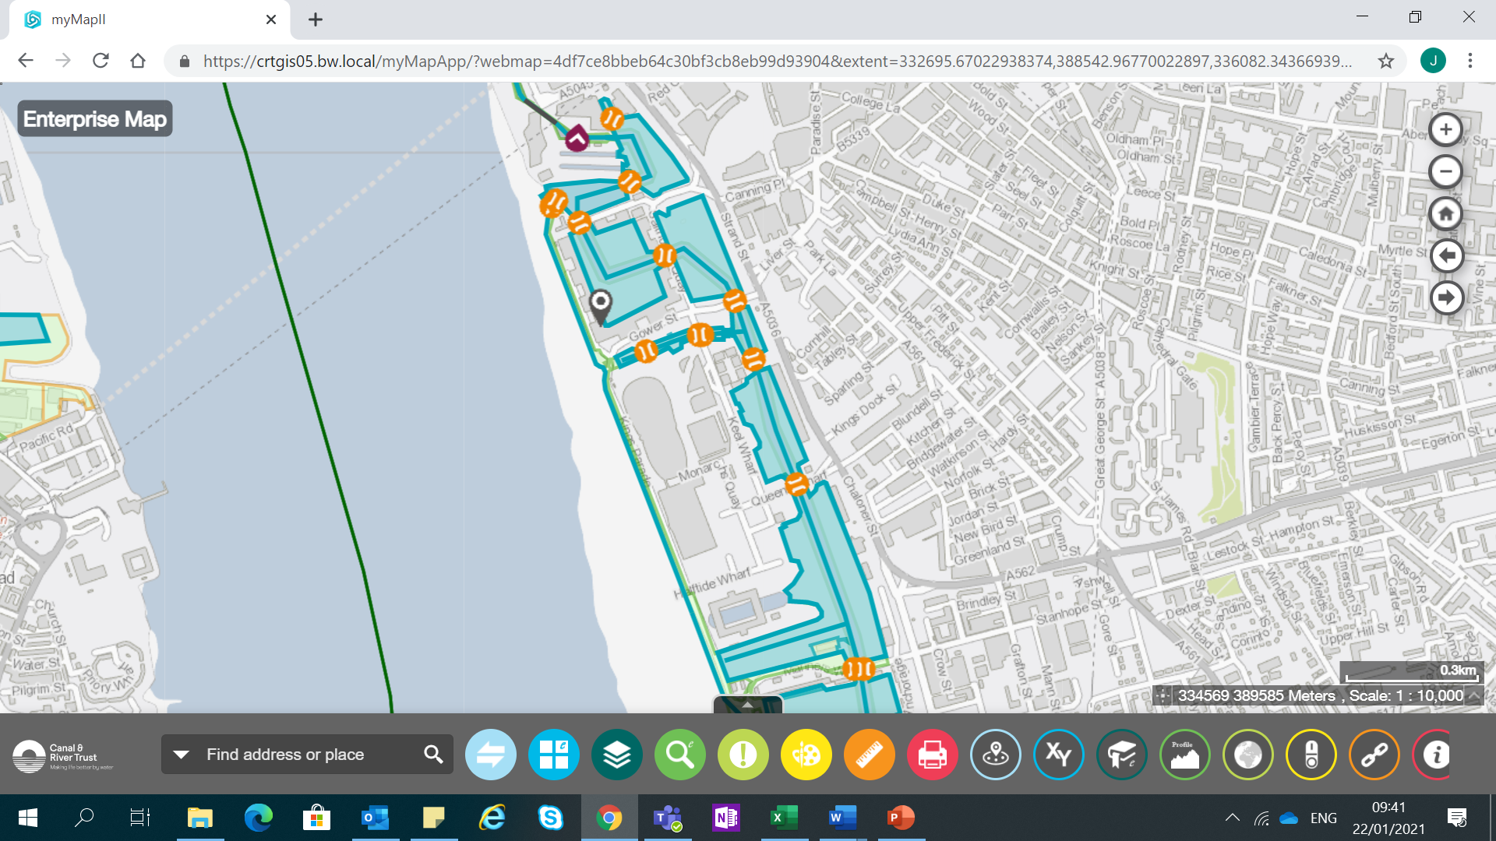
Liverpool South Docks
Albert Dock to Queen’s Dock

Slide 5
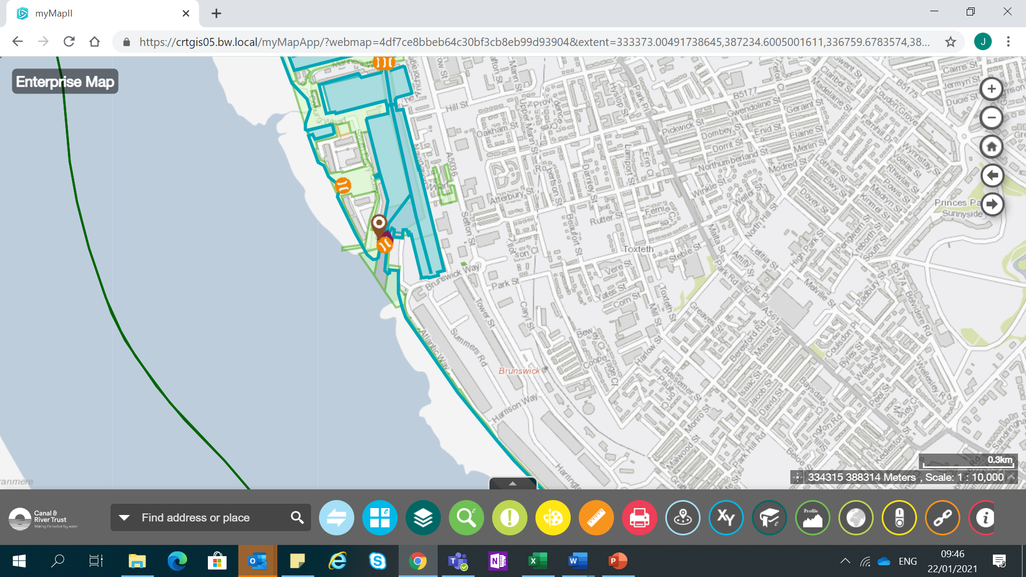
Liverpool South Docks
Coburg Dock
Brunswick Dock
Riverside Walkway

Slide 6
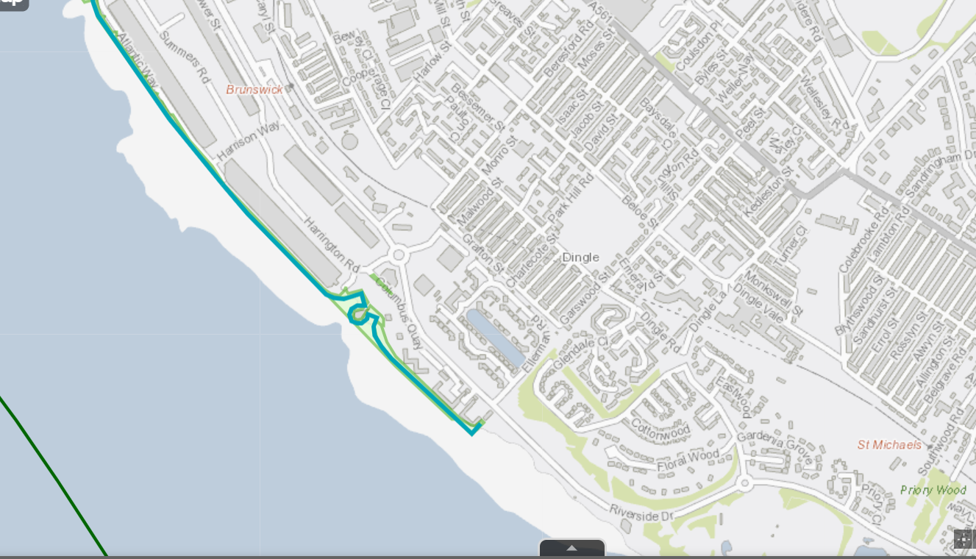
Riverside Walkway
Riverside Walkway
(to end of Trust landownership at Ellerman Rd/Riverside Drive)

Slide 7
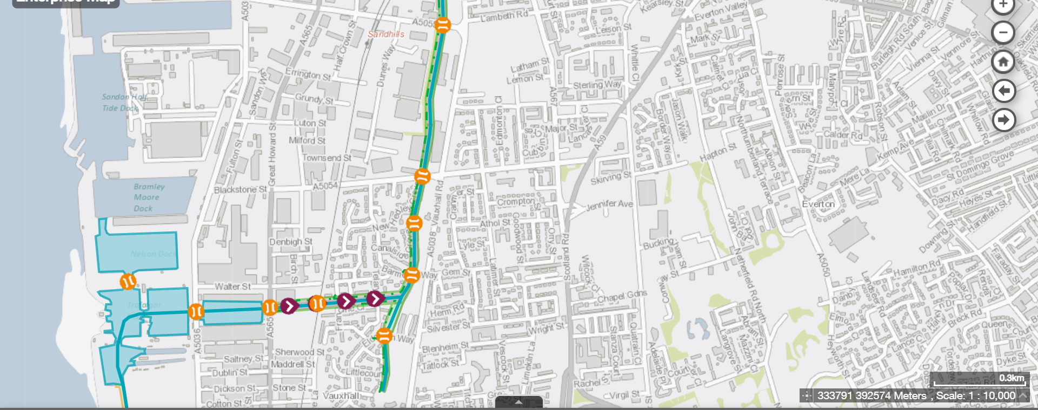
Leeds & Liverpool Canal
Leeds & Liverpool Canal
Stanley Lock Flight/Eldonian Village to Sandhills

Slide 8
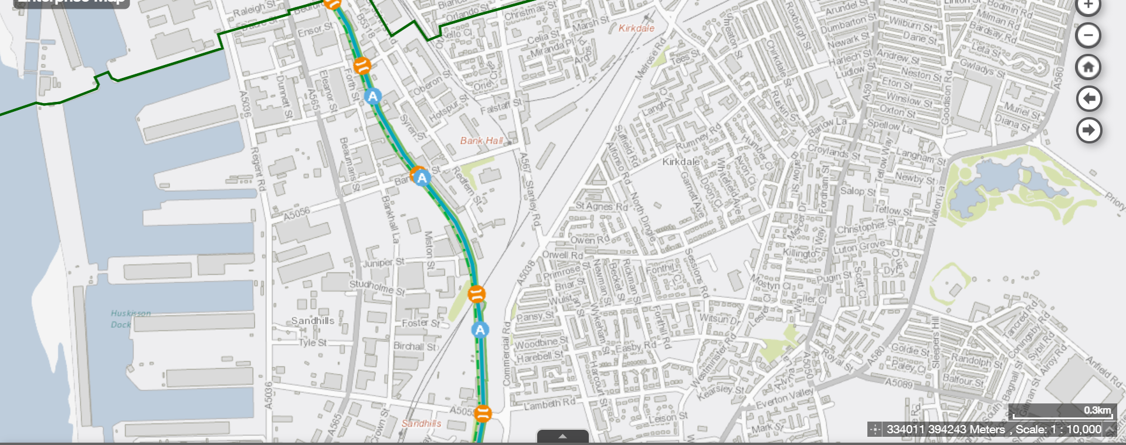
Leeds & Liverpool Canal
Leeds & Liverpool Canal
Sandhills to Liverpool/Sefton boundary (Bedford Place)

