Slide 1

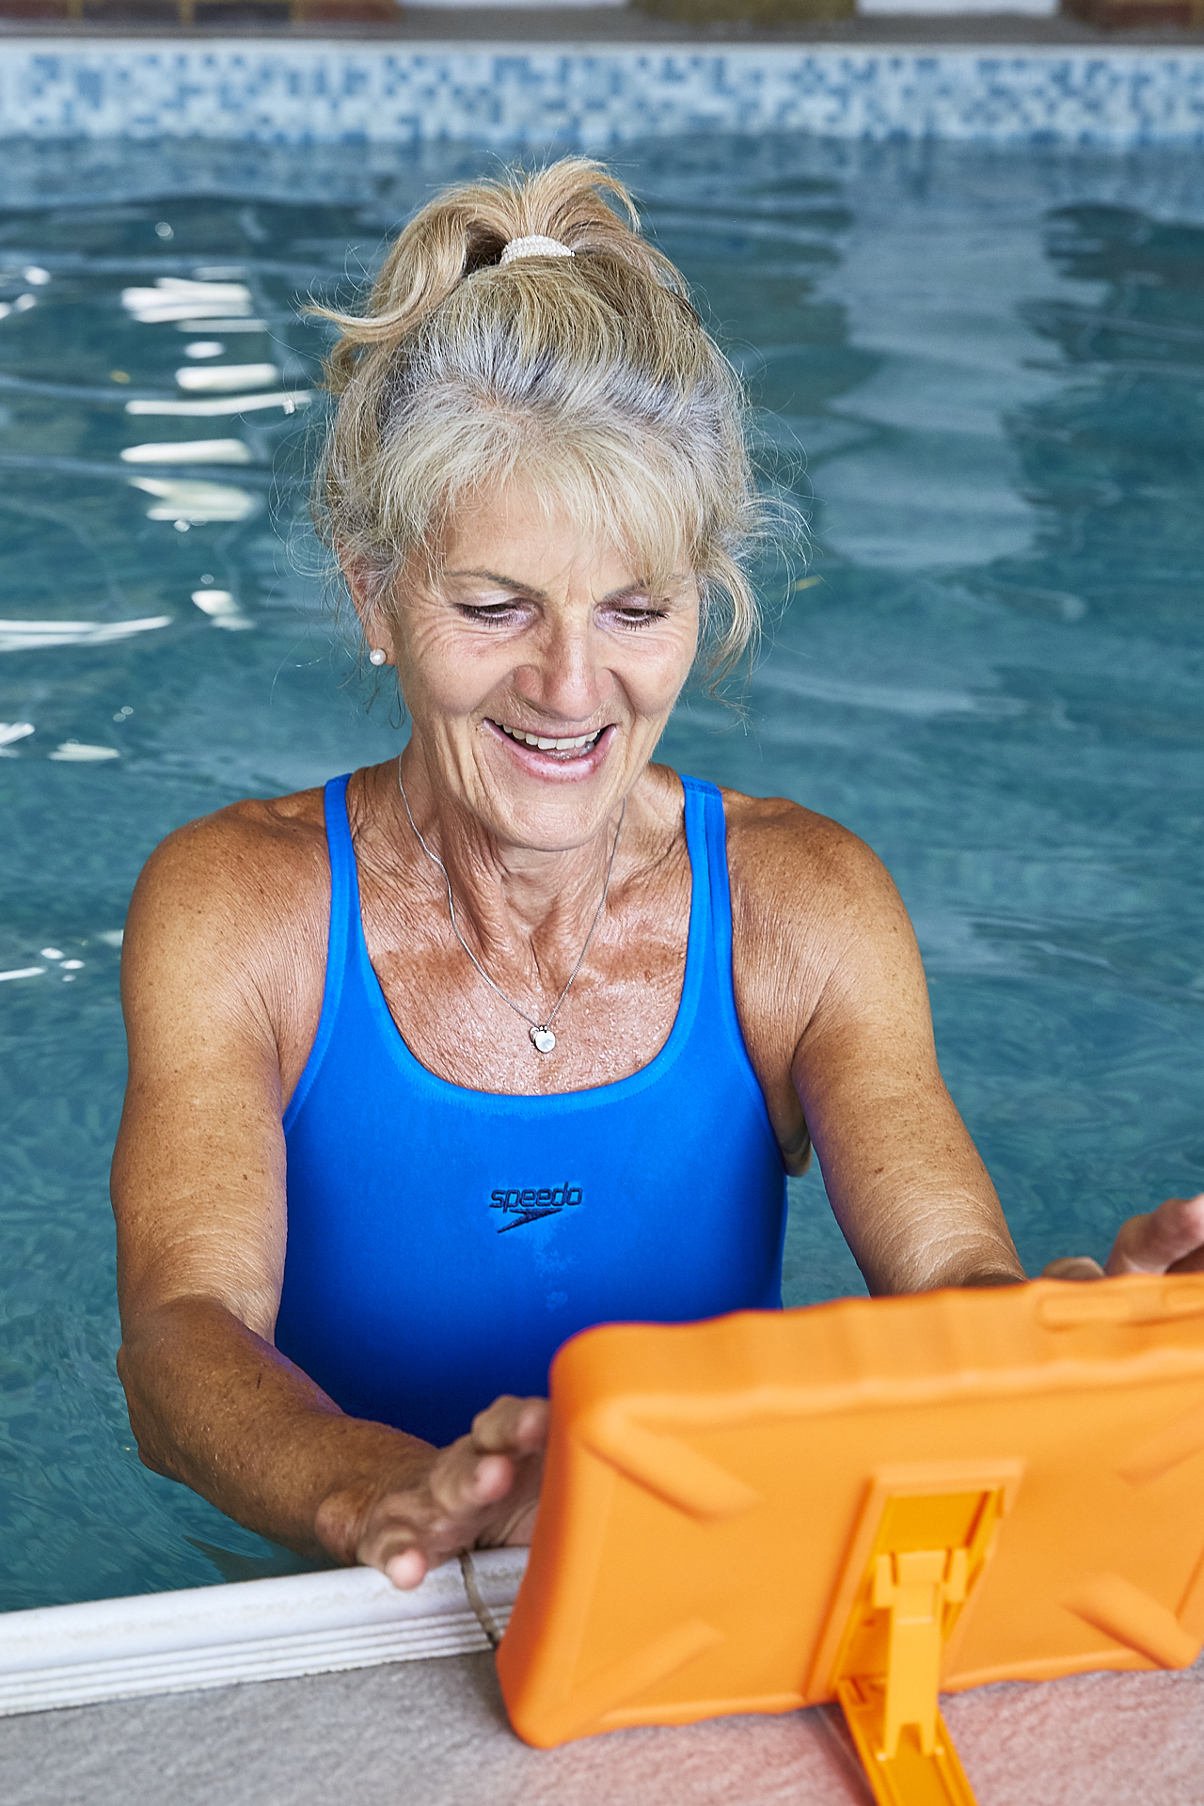
Is joint pain affecting your mobility?
Good Boost creates personalised aquatic exercise sessions designed so you can move more, have fun and feel better.
1
Join one of our Good Boost classes (ask reception or an instructor for more details on signing up)
2
Good Boost’s technology creates an individually-tailored programme designed around your needs and preferences
3
You can follow the exercises at your own pace in the pool on Good Boost’s waterproof tablet computers
Sessions
Lifestyles Ellergreen (0151 233 6299) – Monday 3.30pm-4.30pm
Lifestyles Alsop (0151 233 1501) – Wednesday 7.15pm-8.15pm
Friday 9.30am-10.30am
Visit www.goodboost.org for more information

